Slide 1
Trauma Centred Care
July 6f, 2018

Slide 2
Trauma Defined
Regardless of its source, trauma contains three common elements:
It was unexpected
The person was unprepared
There was nothing the person could do to stop it from happening
Simply put, traumatic events are beyond a person’s control

Slide 3
Trauma is when we have encountered an out of control, frightening experience that has disconnected us from all sense of resourcefulness or safety or coping or love.
- Tara Brach

Slide 4
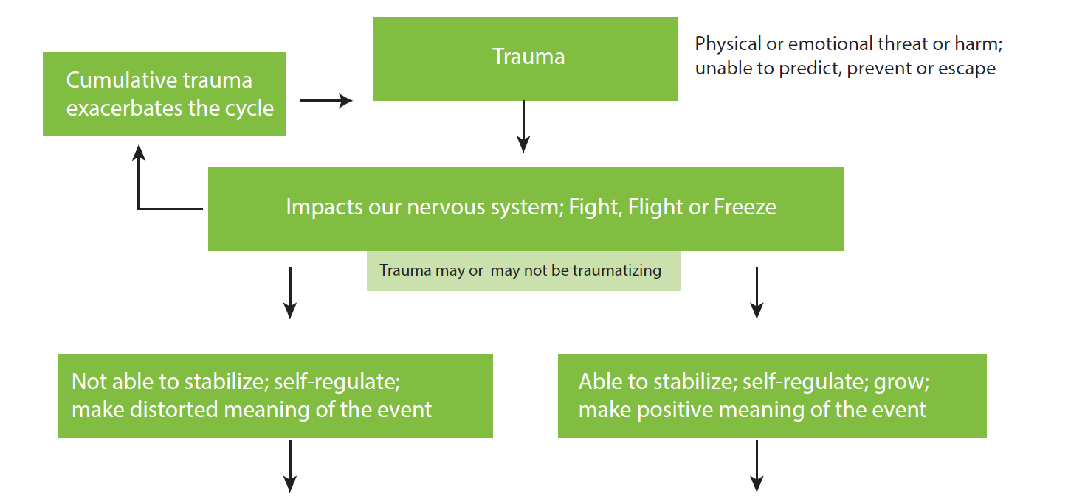

Slide 5
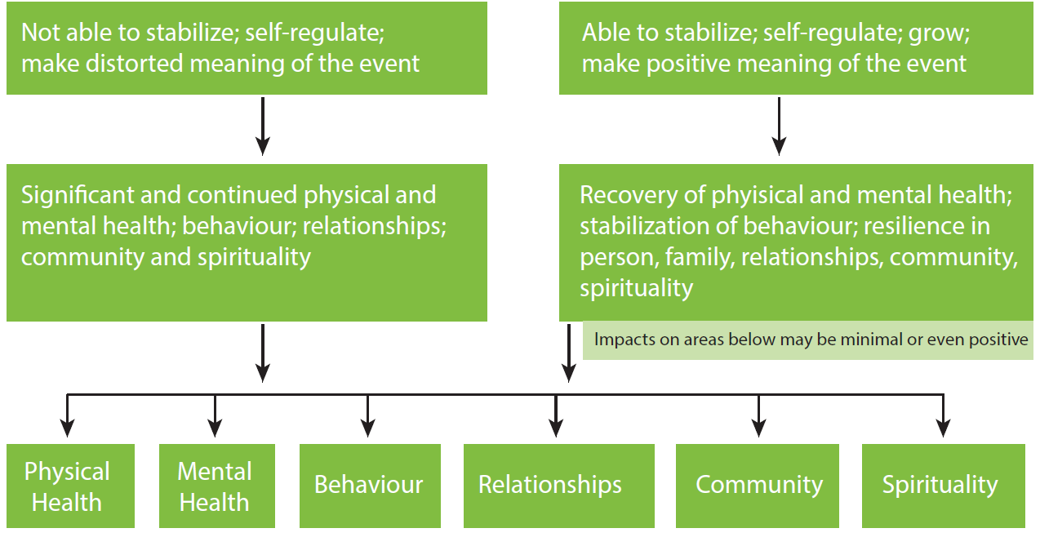

Slide 6
The PTSD Triad
An individual with PTSD alternates between:
Reliving the trauma; and,
Avoiding reminders of the trauma;
Additionally, while this alternating is going on, the person also has symptoms of hyperarousal within their bodies - that is, their bodies are constantly in “fight-flight-or-freeze” mode.

Slide 7
(1) Reliving The Trauma
Recurrent or intrusive thoughts, images or memories of the event
Nightmares or distressing dreams in which the trauma re-emerges
Flashbacks, illusions or hallucinations. These images might cause the person to act or feel as if the traumatic event was still occurring, giving her a sense of reliving the experience.
Mental or emotional anguish when something happens to trigger a recollection of some aspect of the event
Physical reactions when something triggers a memory of the trauma.

Slide 8
(2) Avoidance and Numbing
An effort to avoid thoughts, feelings or conversations associated with the trauma
An effort to avoid activities, people or places that bring the trauma to mind
An inability to remember an important aspect of the trauma
A noticeable disinterest in doing things that were enjoyable before the traumatic experience
A feeling of detachment or estrangement from others
Difficulty having or showing loving feelings or being intimate or sexual
A sense of a foreshortened future in which the person doesn’t expect to have a career, marriage, children or a normal life span

Slide 9
(3) Hyperarousal
Difficulty falling or staying asleep
Irritability or outbursts of anger
Difficulty concentrating on or completing tasks
Hypervigilance (which is an extreme sense of caution that may sometimes resemble paranoia)
Exaggerated startle response

Slide 10
Simple vs. Complex PTSD
Simple PTSD:
involves these three key characteristics that take place after one traumatic event (MVA, act of war, sexual assault)
Complex PTSD:
Is also characterized by intrusive experiences, avoidance and hyperarousal, but develops over time due to repeated and prolonged abuse and neglect

Slide 11
Responses to Repeated and Prolonged Abuse
Repeated and prolonged abuse has been shown to have significant impact on an individual’s physiological development (brain, startle response system) as well as personality and social development.
Early abuse has a profound impact on the individual’s attachment system, personal relationships and sense of self.
Physical symptoms are also common in response to the psychological/emotional distress
Chronic sexual abuse has been shown to compromise individuals’ immune systems – depression and a variety of anxiety disorders are also often present

Slide 12
PTSD and Co-occurring Disorders
Anxiety disorders (such as panic attacks, phobias, incapacitating worry or compulsions)
Mood disorders (such as depression)
Disruptive behaviour disorders (such as attention deficit or antisocial personality disorder)
Addictive disorders (such as addiction to or abuse of alcohol or street or prescription drugs)
Chronic physical illness (such as diabetes, heart disease or liver disease)
Chronic physical pain due to physical injury or illness or due to no clear physical cause

Slide 13
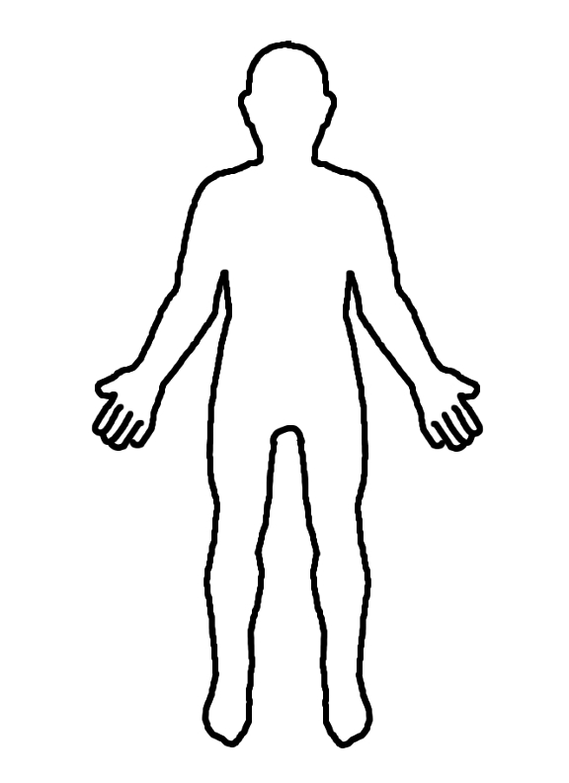
Psychiatric diagnosis of an essential physiological phenomenon.
The physical changes that occur during trauma due to a fight/flight/freeze survival response carried into situations where there is no danger.
Autonomic reactions, not a matter of will. When a reminder is associated with the trauma, it signals to the brain that danger is imminent – the body then reacts accordingly.

Slide 14
These survival mechanisms are maladaptive in a world where thriving depends on the ability to think clearly and logically and to maintain complex social relationships.

Slide 15
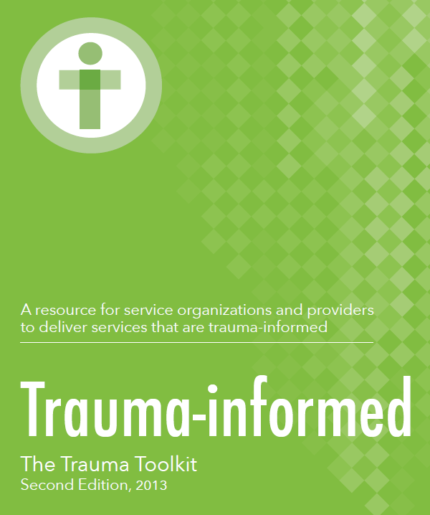
“People affected by trauma from abusive relationships will frequently encounter services that mirror the power and control they experienced in those relationships.”

Slide 16
“At its core the trauma-informed model replaces the labelling of clients as being ‘sick’ … with that of being affected by an ‘injury.’ Not ‘What is wrong with you?’ but ‘What has happened?’”

Slide 17
A warm, accepting attitude creates an island of emotional safety for her in the midst of a situation that the traumatized part of her feels is dangerous.

Slide 18
Qualities Essential to Working with People Affected by Trauma
Empathy
Compassion
Able to talk openly
Self-aware
Self-care and wellness
Flexible
Comfortable with the unknown
Willingness to learn from clients
Willingness to connect emotionally with the client’s experience of trauma
Willingness to step into the world of the client
Able to regulate own emotions
Able to treat the client as an equal and collaborator
Good listener
Willingness to debrief

Slide 19
“Trauma-informed services do not need to be focused on treating symptoms or syndromes related to trauma …”

Slide 20
“Rather, regardless of their primary mission, their commitment is to provide services in a manner that is welcoming and appropriate to the special needs of those affected by trauma.”

Slide 21
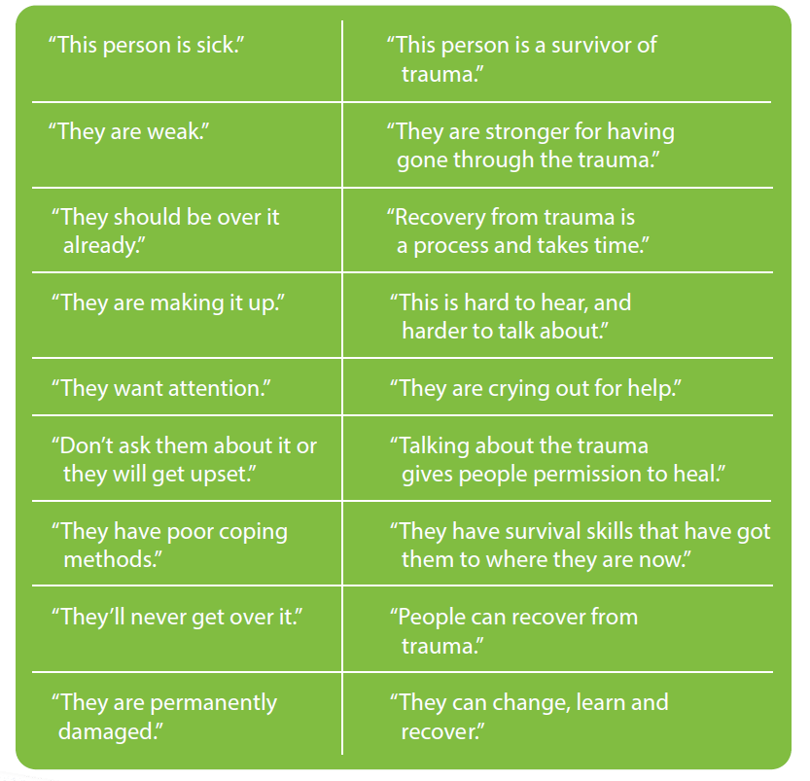

Slide 22
Triggers, Mindfulness and Grounding

Slide 23
External Stressors
Sights, sounds, smells, touches, people, tasks, locations, dates, or situations associated with the trauma
Discussions and media coverage about trauma
Family and work pressures
Negative local, national or international events
Life transitions
Physical confinement (traffic jams, medical appointments, social events

Slide 24
Internal Stressors
Any physical or emotional conditions similar to those experienced during the trauma, particularly:
physical discomfort
strong emotions
feelings towards friends, caregivers or partners

Slide 25
Trigger Management
STEP ONE: Identify the triggers.
Which people, places, things touches, tasks, dates, emotions, physical conditions or situations seem to increase your PTSD symptoms? List as many triggers as you wish.

Slide 26
Trigger Management (cont.’d)
STEP TWO: Raise awareness of trigger reactions.
How do you tend to react to each specific trigger you listed in Step One? Which particular symptoms does this trigger tend to bring forth? Do you become more anxious or more shut down – or do you cycle between the two?

Slide 27
Trigger Management (cont.’d)
STEP THREE: Brainstorm safe and helpful approaches to trigger reactions.
List all the safe ways you have tried or could imagine trying to manage your trigger reactions that were helpful. Include any safe action you took, even if it only helped a little while or a small amount. Possibilities could include psychological strategies or could include seemingly minor things such as drinking a glass of juice, sitting in a favorite room, journaling, or saying a short prayer like the Serenity Prayer.
Also list safe and helpful things that others have done, even if they only helped a little.

Slide 28
Asking About Traumatic Experiences

Slide 29
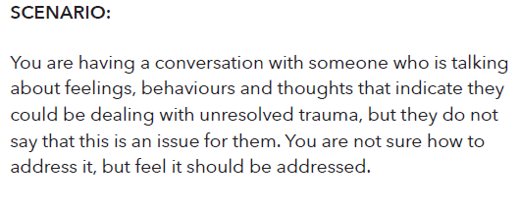
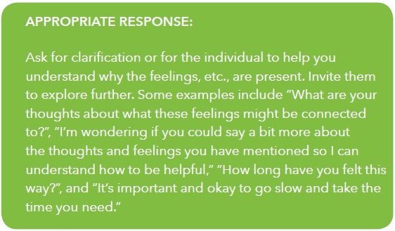
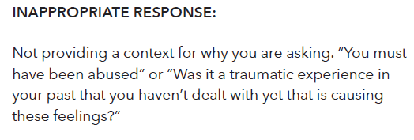

Slide 30
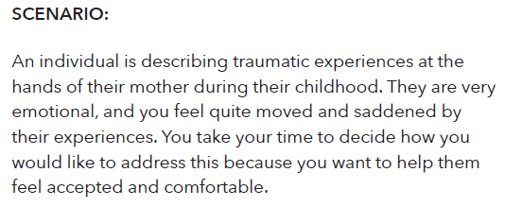
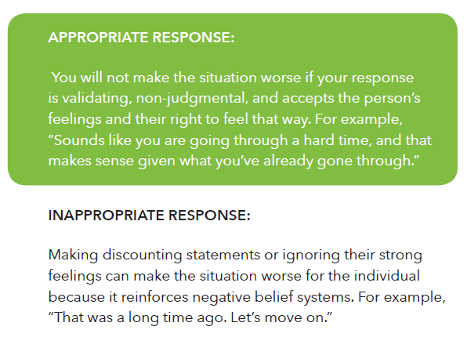

Slide 31
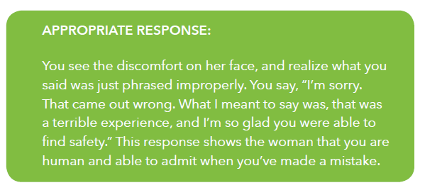

Slide 32
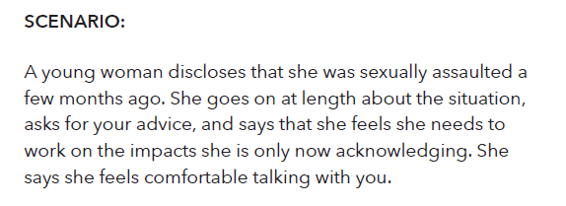
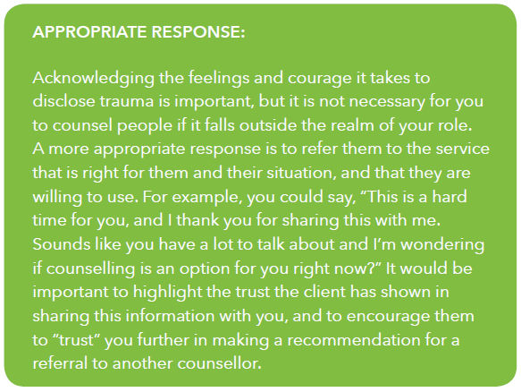
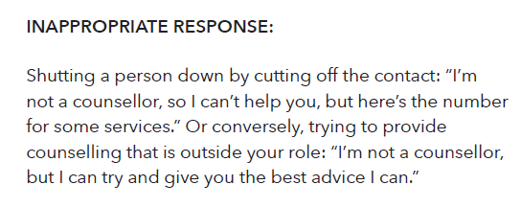

Slide 33
