Slide 1
Maximizing Tutela – Tools and Strategies
Presented by:
Pascal St. Jean
SK Teal

Slide 2
Agenda
Search More Effectively for Resources
Share Resources with Students
Explore New Ways to Gain PD Hours
Manage your PD Account to Track your Hours

Slide 3
Search More Effectively
Notes:
Demo on live site

Slide 4
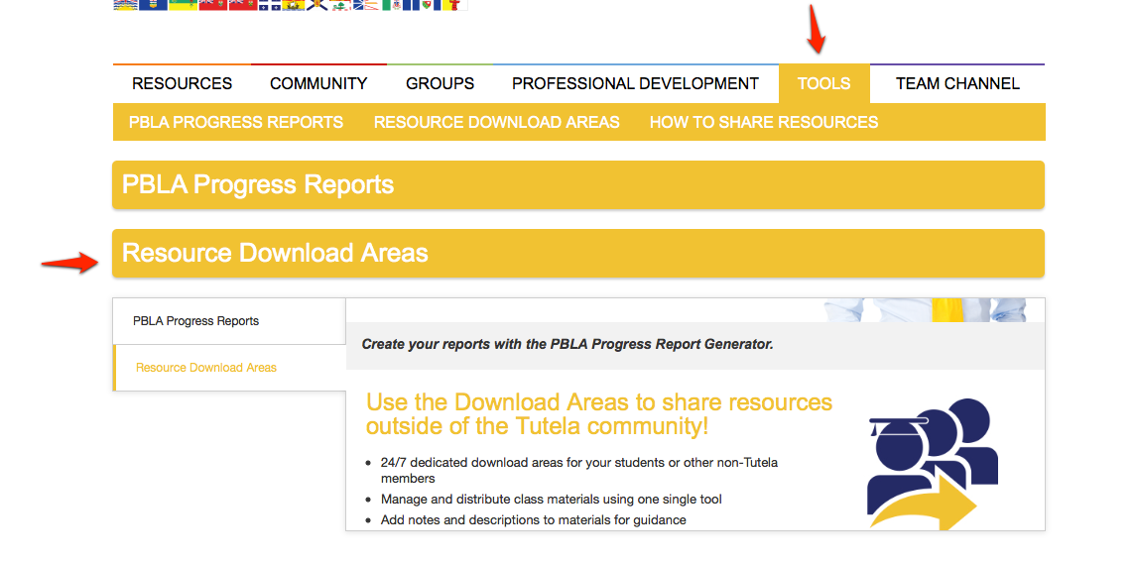
Resource Download Tool
Notes:
Demo on live site – tutorial? – Team Channel

Slide 5
Resource Download Tool
Notes:
Demo on live site – tutorial? – Team Channel

Slide 6
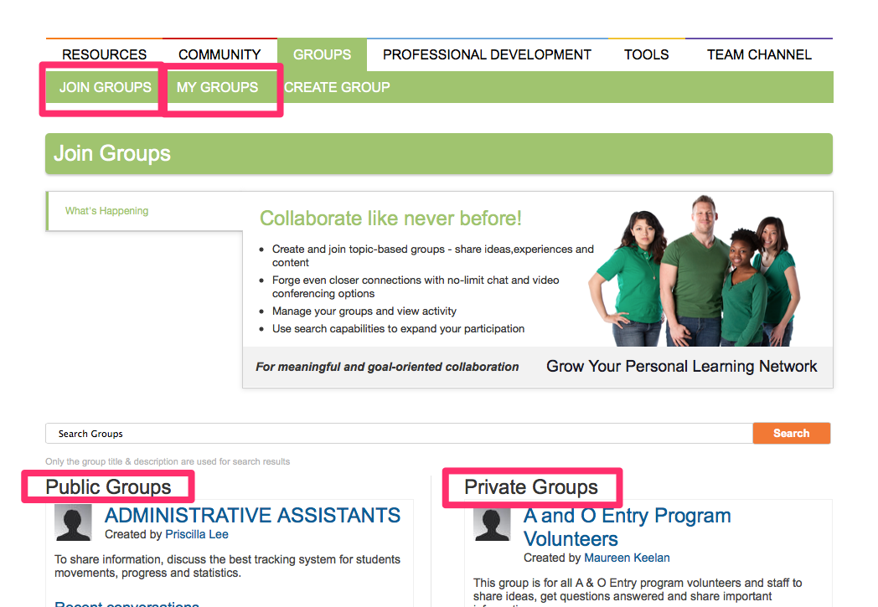
Groups
Notes:
Draw attention to join groups (default) and my groups.

Slide 7
Events – Tutela Webinars

Slide 8
PD – Live and Recorded Webinars

Slide 9
PD – Live Webinars

Slide 10
PD – Live Webinars
Notes:
Join webinar icon pops up only when room is open about 15 minutes before.

Slide 11
PD – Live Webinars
Notes:
If it isn’t a Tutela webinar, look for a link to a 3rd party website.

Slide 12
PD – Recorded Webinars
Notes:
Click on the webinar recording that interests you.

Slide 13
PD – Recorded Webinars
Notes:
Only Tutela webinars will have the recording on the page itself.

Slide 14
PD – Recorded Webinars

Slide 15
PD – Recorded Webinars
Notes:
For non Tutela webinars – look for a 3rd party link to their recordings.

Slide 16
Create, Collaborate, Participate, Share
Continue to use Tutela with your colleagues, peers and other members from across Canada.
Thank You

